Slide 1
Name: Shivani
Sanjaya
Saveetha
Sowmiya
Pranitha sri
Srimathi
Subject code:
Subject:Physics for computer communication

Slide 5
Hjkfqeqejbfqf

Slide 7
Calculate interplanar distance, crystal size (grain size), hkl value, lattice parameter and crystal structure. Given as 2 θ and β value.
2θ (°) | β
28.44 | 0.162
47.30 | 0.174
56.12 | 0.179
69.13 | 0.185
76.38 | 0.188

Slide 8
To Find θ(°) ,sinθ(°) ,cosθ(°)
θ(°) /2 | θ(°)
28.44 /2 | 14.22
47.30 /2 | 23.65
56.12 /2 | 28.06
69.13 /2 | 34.565
76.38 /2 | 38.19
Sin(θ(°) ) | sinθ(°)
Sin(14.22) | 0.2436
Sin(23.65) | 0.4011
Sin(28.06) | 0.4703
Sin(34.565) | 0.5673
Sin(28.19) | 0.6182
Cos(θ(°) ) | cosθ(°)
Cos(14.22) | 0.9693
Cos(23.65) | 0.9160
Cos(28.06) | 0.8824
Cos(34.565) | 0.8234
Cos(28.19) | 0.7859

Slide 9
Find interplanar spacing
2dsinθ(°) =nλ
d=nλ/2sin θ(°) where (λ=5406Å)
1.d=1*5406/2*0.2456 = 3.136Å
2.d=1*5406/2*0.4011 = 1.920Å
3.d=1*5406/2*0.4703 = 1.637Å
4.d=1*5406/2*0.5673 = 1.357Å
5.d=1*5406/2*0.6182 = 1.246Å

Slide 10
Particle size determination
Scherrer formula D=k λ/ βcos θ (°) where(k=0.9)
1. D=0.9*1.5406/0.162*0.9693 = 8.829Å
2. D=0.9*1.5406/0.174*0.9160 = 8.729Å
3. D=0.9*1.5406/0.179*0.8824 = 8.778Å
4. D=0.9*1.5406/0.185*0.8234 = 9.134Å
5. D=0.9*1.5406/0.188*0.7859 = 9.384Å

Slide 11
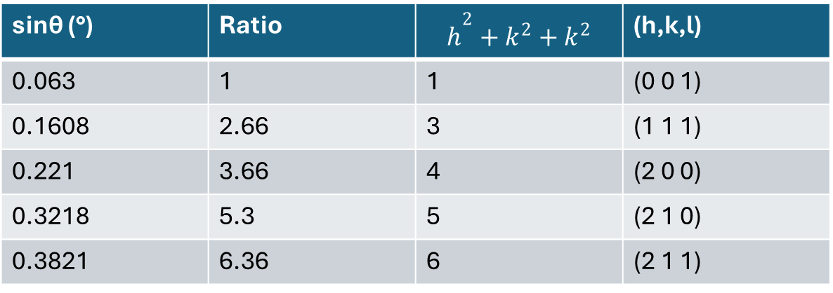
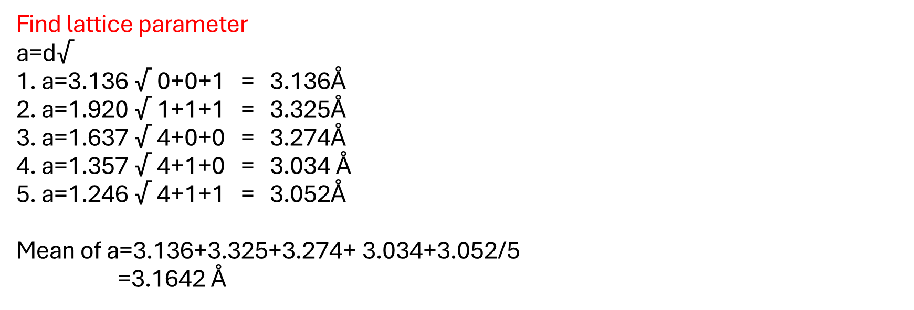
Find lattice parameter a=d√$h^{2}$ 1. a=3.136 √ 0+0+1 = 3.136Å 2. a=1.920 √ 1+1+1 = 3.325Å 3. a=1.637 √ 4+0+0 = 3.274Å 4. a=1.357 √ 4+1+0 = 3.034 Å 5. a=1.246 √ 4+1+1 = 3.052Å Mean of a=3.136+3.325+3.274+ 3.034+3.052/5 =3.1642 Å
sinθ (°) | Ratio | $$h^{2}+k^{2}+k^{2}$$ | (h,k,l)
0.063 | 1 | 1 | (0 0 1)
0.1608 | 2.66 | 3 | (1 1 1)
0.221 | 3.66 | 4 | (2 0 0)
0.3218 | 5.3 | 5 | (2 1 0)
0.3821 | 6.36 | 6 | (2 1 1)

Slide 12
Result
The crystal is Gallium Nitride.
Crystal structure is Hexagonal crystal structure.

